Slide 1

THE IA
IA - 4 - Criteria C

Slide 2
CRITERIA C - SYSTEM OVERVIEW
150 words recommended
Criteria C has THREE parts
  System model
  Algorithms
  Testing strategy
It must line up with Criteria A and B - same success criteria, same components

Slide 3
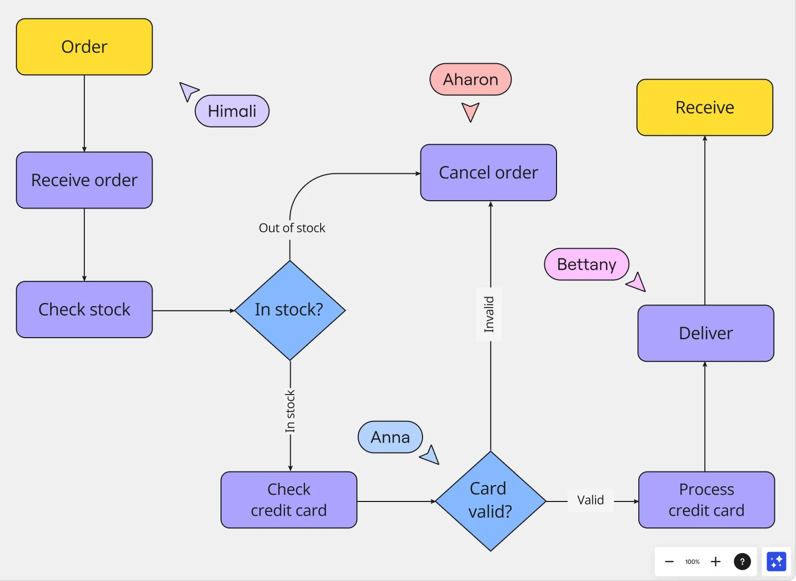
SYSTEM MODEL
Diagrams showing the components of your system and how they connect
Includes the design of your user interface
Shows the rules governing how the components interact
Does NOT include the algorithms - those are the next section

Slide 4
SYSTEM MODEL
What to draw depends on what you are building
  Procedural: flow charts and data flow diagrams
  Object-oriented: UML class diagrams - yes, NOW you may
  Database: entity relationship diagrams - also now
  Everyone: mockups of every screen the user will see
Files, databases and networking details are components too
  Please don’t do networking, I’m begging you

Slide 5
ALGORITHMS
There should be one algorithm for each component you named in the model
  Pseudocode, flow charts, or numbered plain English
  Detailed enough that someone could code from it
The markscheme asks whether your algorithms let the product perform
Do NOT make one huge algorithm for the whole program
  The components, when put together, should create the whole program, you’re sorta piecemealing it

Slide 6
TESTING STRATEGY
A systematic way of checking the product meets your success criteria
A table works best - three columns
  Success criterion | Test | Expected result
One row for every success criterion from Criteria A
Include extreme and abnormal data, not just correct and incorrect data

Slide 7
TESTING STRATEGY
Extreme data is at the edge of what is allowed
  These are also called edge cases
  A name of 60 characters, a quantity of 0, the last day of the month
Abnormal data is what should be rejected
  Letters in a number field, an empty form, a file that isn't there

Slide 8
THE THIRD PARTY TEST
The guide says Criteria C needs the clarity to let a third party recreate the product
So: if I handed your Criteria C to a stranger who codes, could they build it?
Could they build it without asking you a single question?

Slide 9
MARKSCHEME
Marks | Level descriptor
0 | The response does not reach a standard described by the descriptors below.
1-2 | The response: • outlines a limited system model • identifies algorithms for the components of the system model • identifies a testing strategy for at least one success criterion.
3-4 | The response: • constructs a system model that is not complete • constructs algorithms for the components of the system model that lead to partial functionality of the product • outlines a testing strategy that aligns with at least three success criteria.
5-6 | The response: • constructs a complete system model • constructs algorithms for the components of the system model that enable the product to perform • describes a testing strategy that aligns with the success criteria.

Slide 10
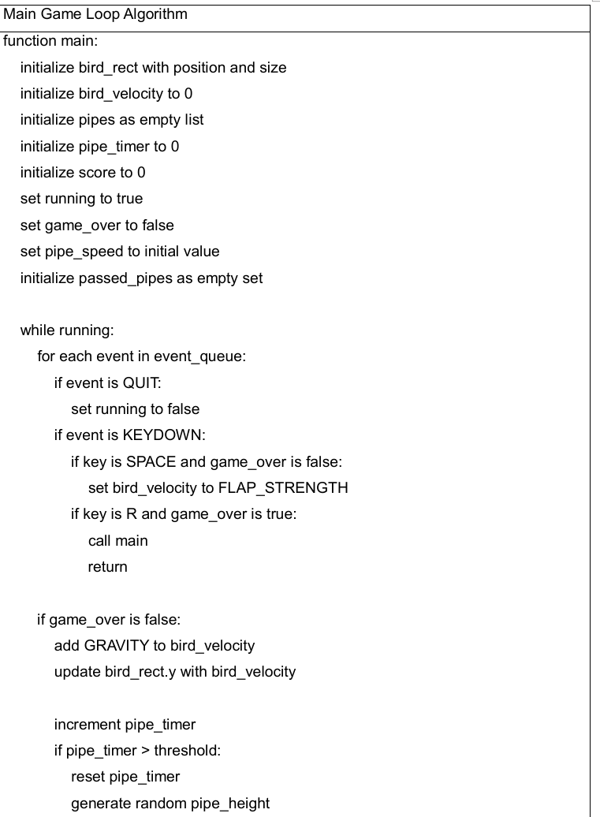
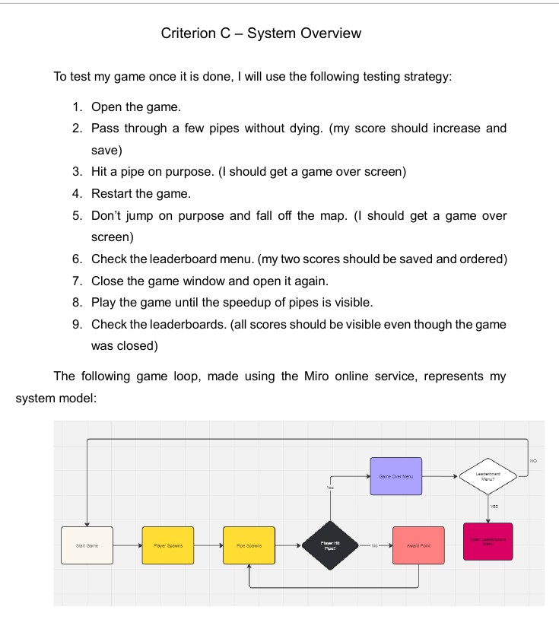
LET'S DO SOME MARKING
What do we think this got, out of 6?
Flappy Bird
Criteria C pages 1 and 2 of 5
  The other three pages just have a few other functions and classes

Slide 11
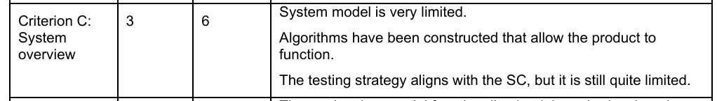
LET'S DO SOME MARKING
It got a 3 out of 6
"System model is very limited"
"Algorithms have been constructed that allow the product to function"
"The testing strategy aligns with the SC, but it is still quite limited"

Slide 12
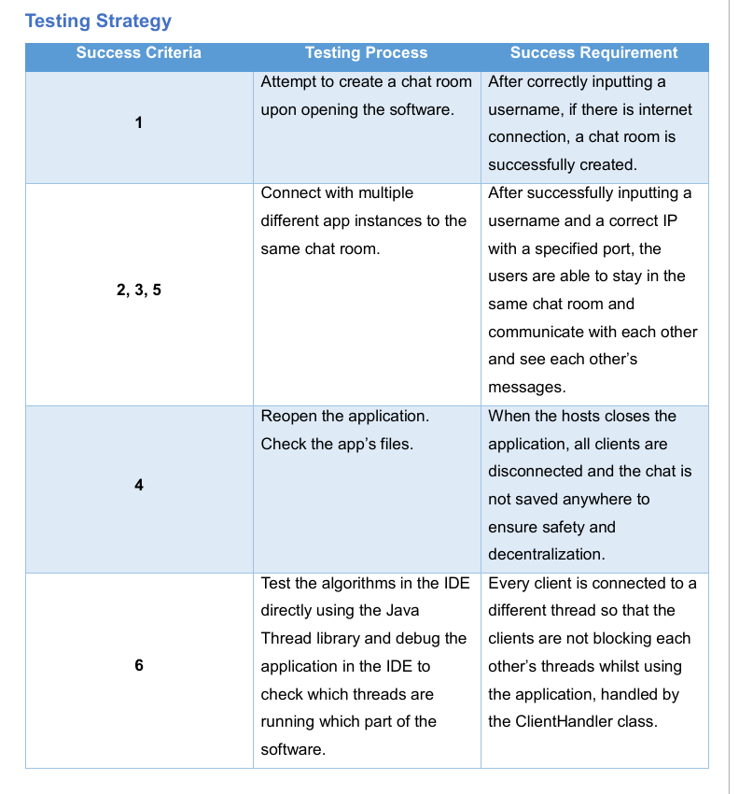
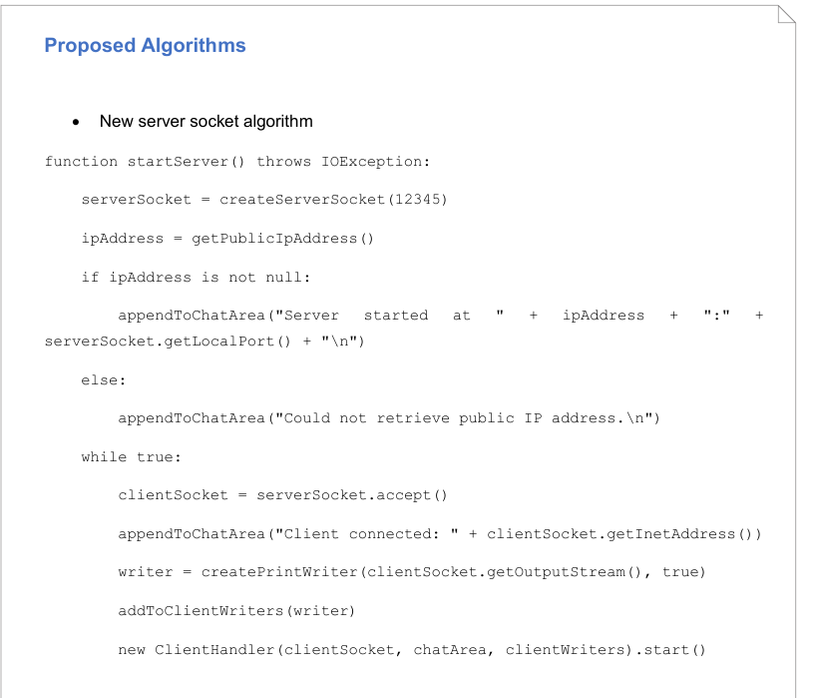
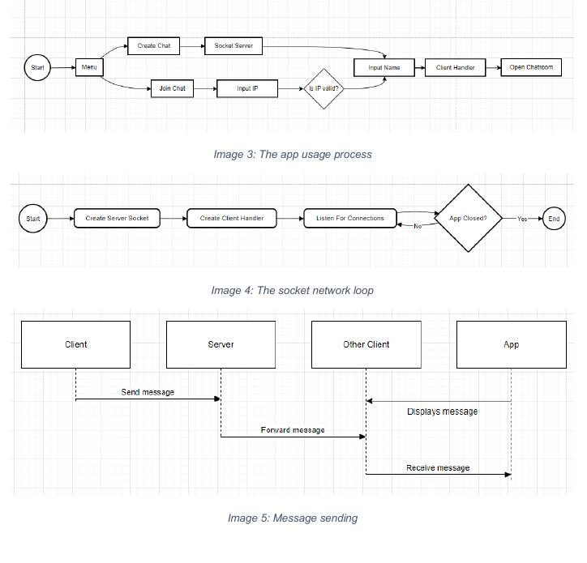
LET'S DO SOME MARKING
How about this one?
Chat Room
Criteria C pages 1, 3 and 6 of 6

Slide 13
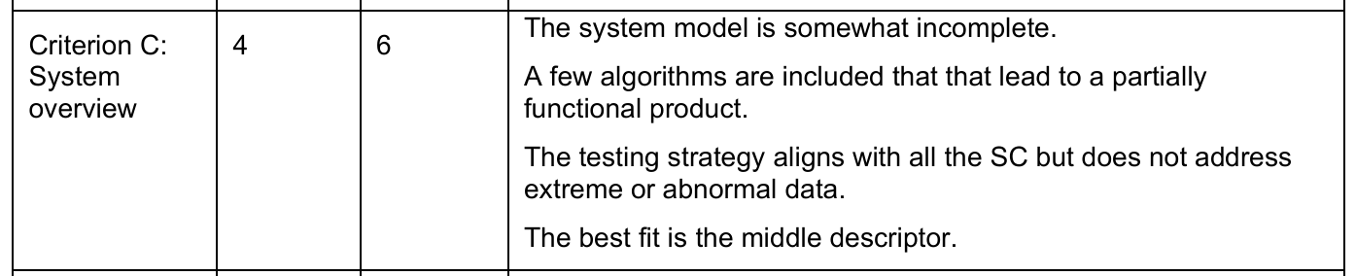
LET'S DO SOME MARKING
A 4 out of 6

Slide 14
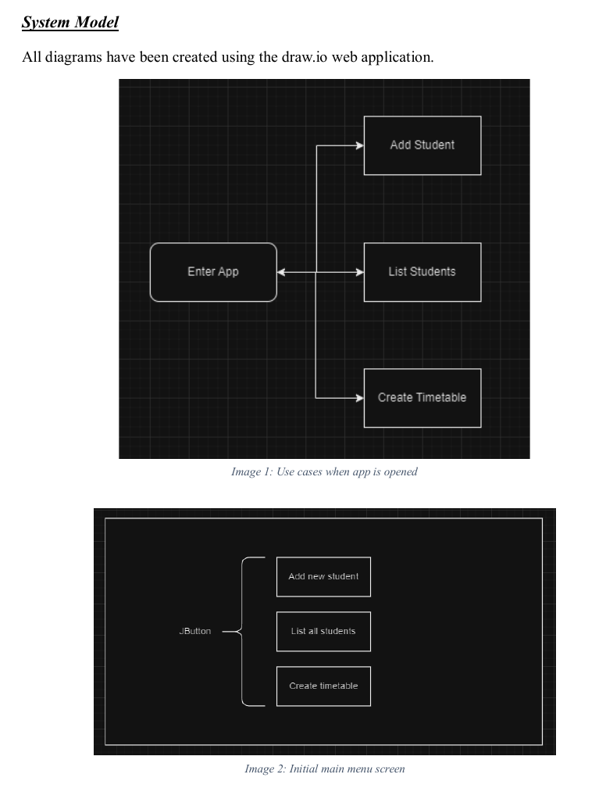
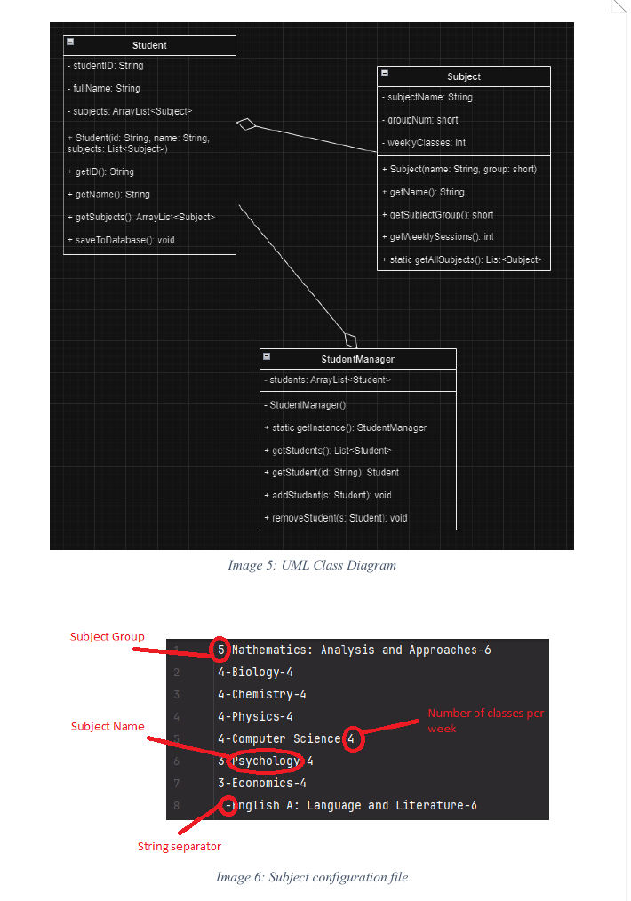
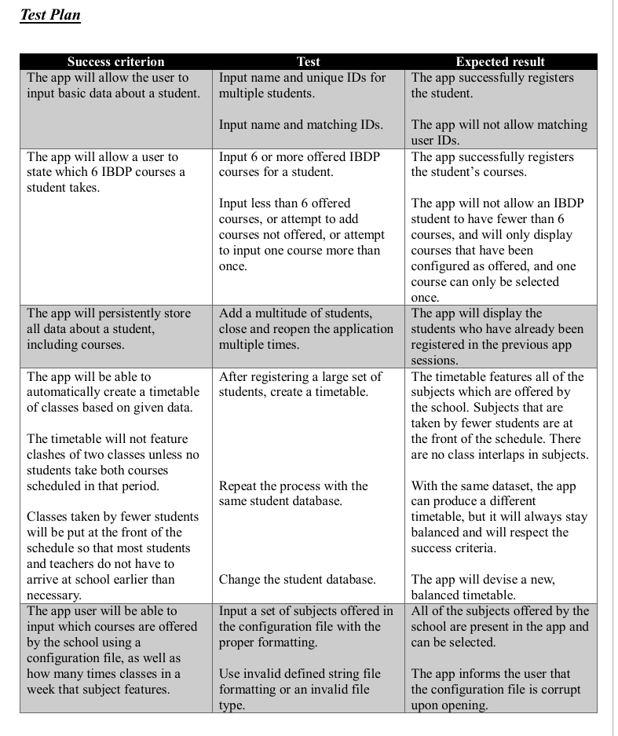
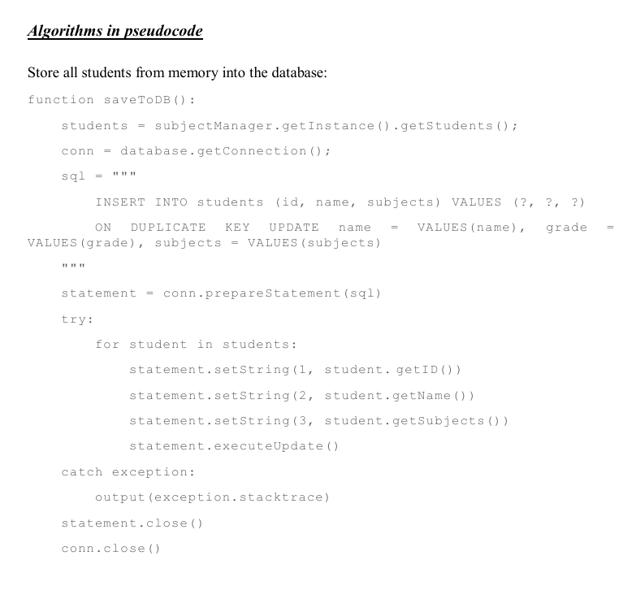
LET'S DO SOME MARKING
One more - Timetable, 26 out of 30 overall
Criteria C pages 1, 3, 5 and 8 of 8

Slide 15
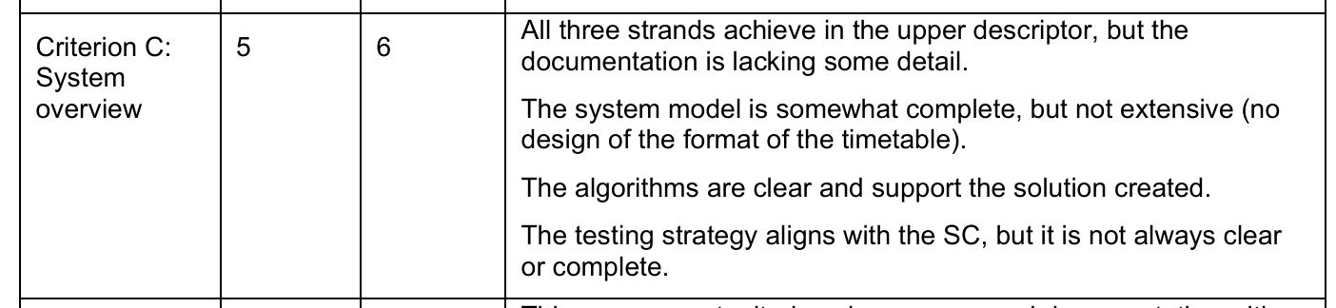
LET'S DO SOME MARKING
A 5 out of 6
No design for the format of the timetable - the output

Slide 16
WHAT A 6 OUT OF 6 WOULD ADD
A diagram for every component - files, databases and network connections included
A UI design for every screen, and for the output of the program
An algorithm for every component you named in the model
A test row for every success criterion, plus extreme and abnormal data
None of our examples here actually do everything, which is likely why we’re missing out on that 6

Slide 17
EXTRA NOTES
It seems the system model is the biggest thing these examples are missing out on
None of the IA examples provided by the IB scored higher than 5/6, so they’re quite greedy with the points here
The algorithms and testing table seem to be more reliable ways to earn points on this criteria

Slide 18
“WORD COUNT”
The IB recommends 150 words for Criteria C
Every example we just looked at is well past that
Do the same move as Criteria B – cram words into those diagrams and tables that DO NOT COUNT
Write about 200 words and put everything else in diagrams
I think we’ll dub this strategy the “free words technique”
  Open to suggestions though, not super happy with it

Slide 19
CRITERIA C - ASSIGNED
Check GitHub for the Criteria C document - WS IA-5 - Criteria C
Rough draft of Criteria C is the next thing due
Next time, we’ll be spending some hands on time with Criteria C to get you a bit more prepared hopefully, so come with your hdzea screwed on straight

